Slide 1
Fortune Freestyle Season Kick-off Event
Welcome!

Slide 2
3 Year Strategic Plan 2018-2021
Vision, Mission, Values
5 Targeted Areas; Striving for Excellence in:
Good Governance
Programming
Coaching
Communication
Relationship to Camp Fortune

Slide 3
Vision, Mission, Mandate
Vision
To bring together athletes in a safe, supportive and welcoming community to build confidence in their skills, grow friendships and develop a lifelong passion for the sport of freestyle skiing.
Mission
To achieve excellence in program delivery, coaching, people management, safety, governance and accountability.
Mandate
To deliver Can Freestyle recreational and competitive programs, sanctioned by Freestyle Ontario and Freestyle Canada, following the Long Term Athlete Development pathway.

Slide 4
Values
All members of our community have a responsibility to:
Keep it Fun: Find the joy in freestyle skiing. Keep a positive attitude both on and off the snow.
Include Everyone: Make sure that no one is left out; everyone matters.
Be Safe: Know your limit; ski within it.
Go For It: Rise to the challenge. Discover how good you can be.
Respect Others: Show respect for everyone involved in the sport of freestyle skiing. Celebrate all achievements big and small. Win with dignity and lose with grace.
Give Back: Find ways to show your appreciation for the community that helps make freestyle skiing possible.

Slide 5
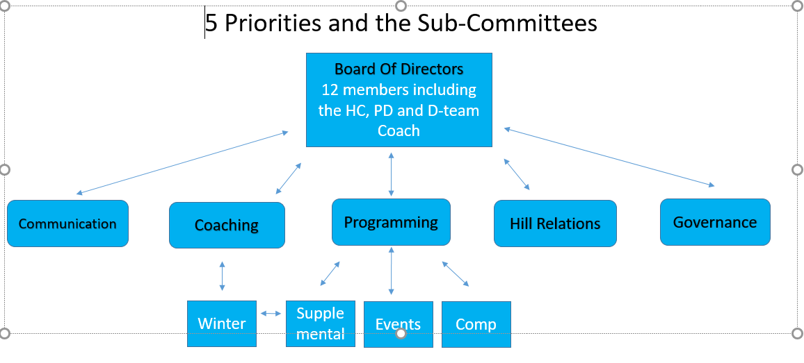
Board Structure

Slide 6
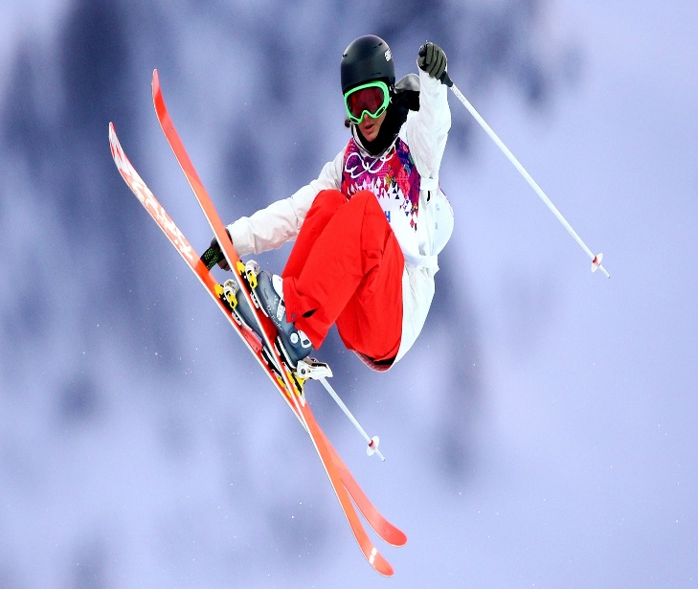
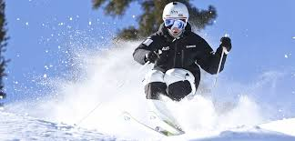
Programming & Pathways!
What will the athletes be doing?

Slide 7
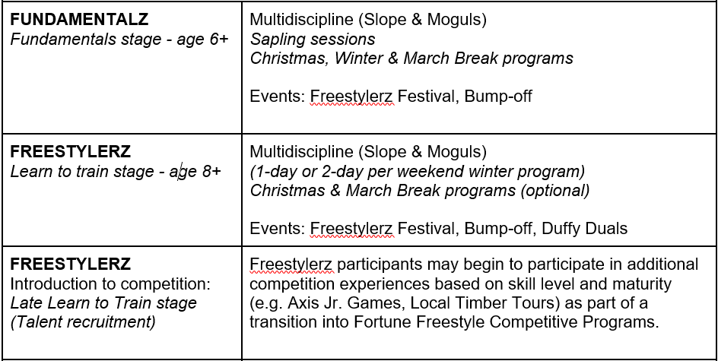
Recreational Programs

Slide 8
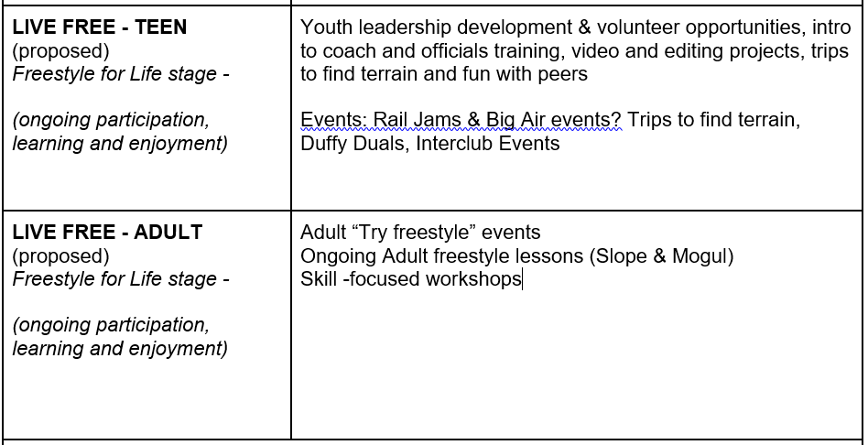
Recreational Programs Con’t

Slide 9
Competitive Pathways

Slide 10
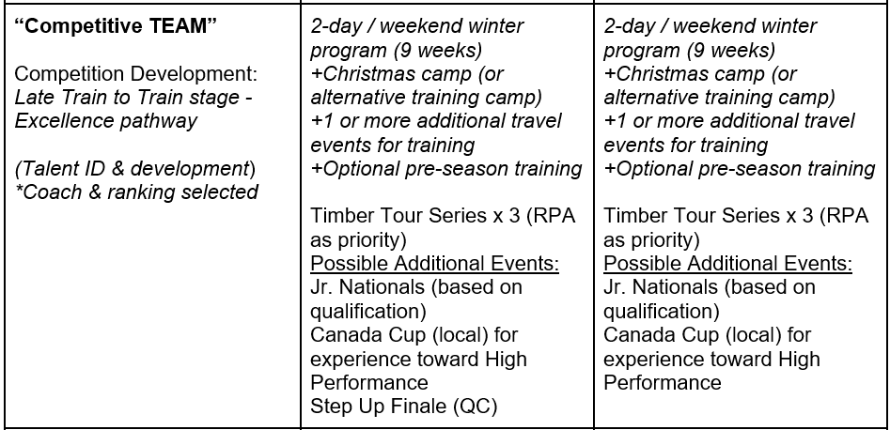
Competitive Pathways Con’t

Slide 11
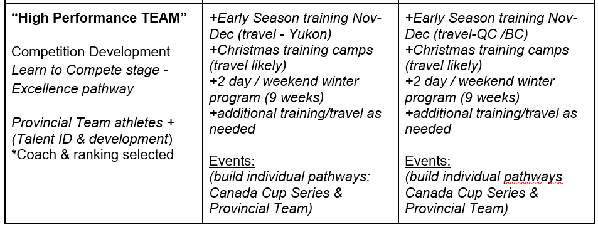
Competitive Pathways Con’t

Slide 12
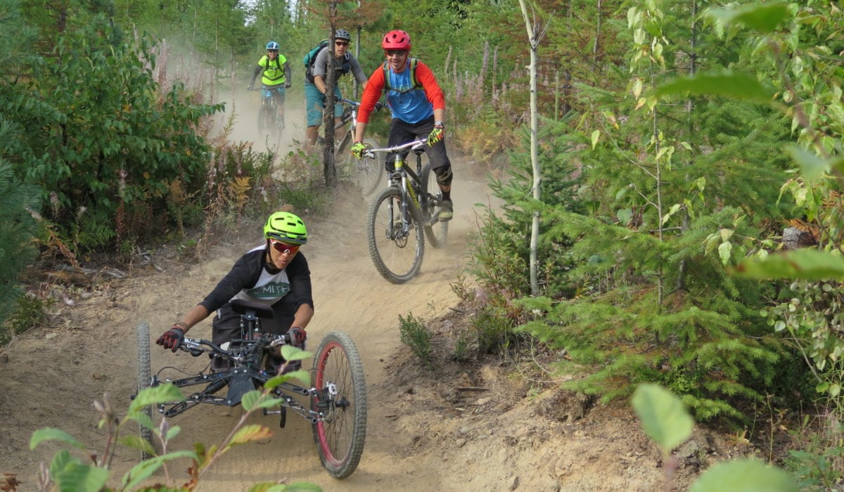
Dryland
Dryland training helps our athletes begin to get ready for the season, get to know the coaches and other athletes while having fun.
10-12 weeks
Varied activities, mountain biking, hiking, parkour, aerial park etc…
Focus on general fitness and fun

Slide 13
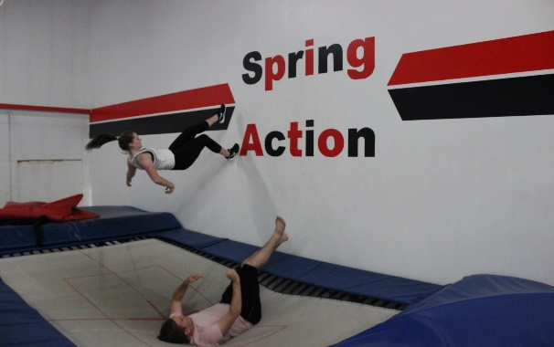
Trampoline Freestyle Program Spring Action
Trampoline is the number one recommended sport for aerial sports as it builds self-confidence, aerial awareness as well as core muscle strength! Spring Action offers dry-land training for all athletes who are looking to perfect their skills before putting them to the test!
Our Freestyle Programs are open to anyone who is looking to work both off-axis and on axis skills! Not only are our coaches certified to teach on-axis flips through the National Coaching Certification Program (NCCP) but they are also experts at off-axis skills. Our coaches have undergone Air Sense training through the Canadian Freestyle Association!
Our programs promote safety by offering proper progressions and multiple steps to off-axis twisting and flipping! Our landings are a lot softer than water and/or the hill making it ideal for cross training!

Slide 14
Safe Sport
It’s Everyone’s Responsibility

Slide 15
Safe Sport
Everyone has the right to enjoy the sport at whatever level or position they participate. Athletes, coaches, officials and volunteers have the right to participate in a safe and inclusive training and competitive environment that is free of abuse, harassment or discrimination.
The welfare of everyone involved in the sport is a foremost consideration and in particular the protection of children/athletes in the sport is the responsibility of each individual, member and special interest group in the athletic community.
Learn more about safe sport, your rights and the code of conduct at:
https://www.protectchildren.ca/en/programs-and-initiatives/commit-to-kids-children-in-sport/
https://commit2kids.ca/pdfs/C2K_CoachingAssocCanada_Interacting_en.pdf

Slide 16
https://www.youtube.com/watch?v=vPqHGRDyhzg

Slide 17
You Can Get Help!

Slide 18
Fortune Freestyle Policies
https://www.fortunefreestyle.com/policies

Slide 19
Volunteer We Need Your Help

Slide 20
Why Volunteer?
Aside from the fact that we need help;
Be part of the community, we rock!
Learn more about the sport your athlete loves.
It’s key to the survival of clubs like ours and we are the biggest.
Meet new people, most of us are pretty cool (except that Harley guy).

Slide 21
Volunteer Insurance
https://freestyleontario.ski/
Associate licence = $25

Slide 22
General call out for help
To run our program effectively and because mother nature can be a bit testy at time, we will send team snap/email requests to help out. Please be on the look out, no experience is needed.
Terrain help; jump builds, shoveling, chopping, clearing etc…

Slide 23
Volunteer Coordinators
Volunteer coordinators that help with the organizing of specific activities.
Supplemental Programming:
Maximise, FF Air bag, Dryland, Water Ramp, Trampoline
Competitive Programming:
D-team Manager x 2
Regular Programming:
Merchandise, Team jackets, Newsletter, Team Snap, Open House
Event Programming:
Kick-off, Bump Off, Freestylerz Festival, Sapling Session, Duffy Duals,Timber Tour

Slide 24
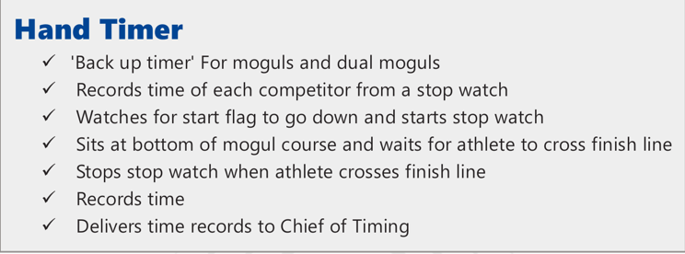
Event Roles
Great First Time Volunteer Positions

Slide 25
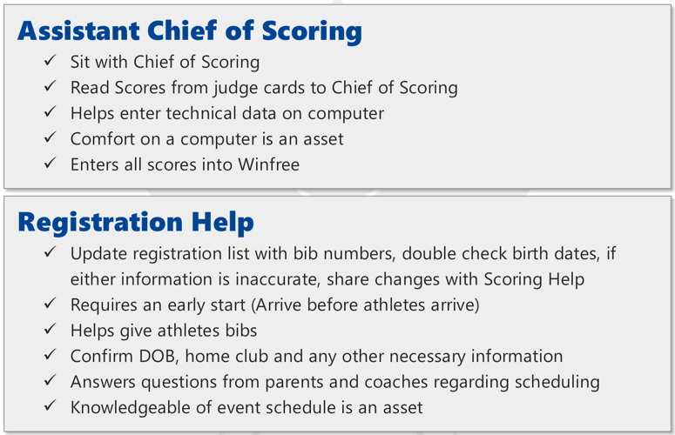
Event Roles

Slide 26
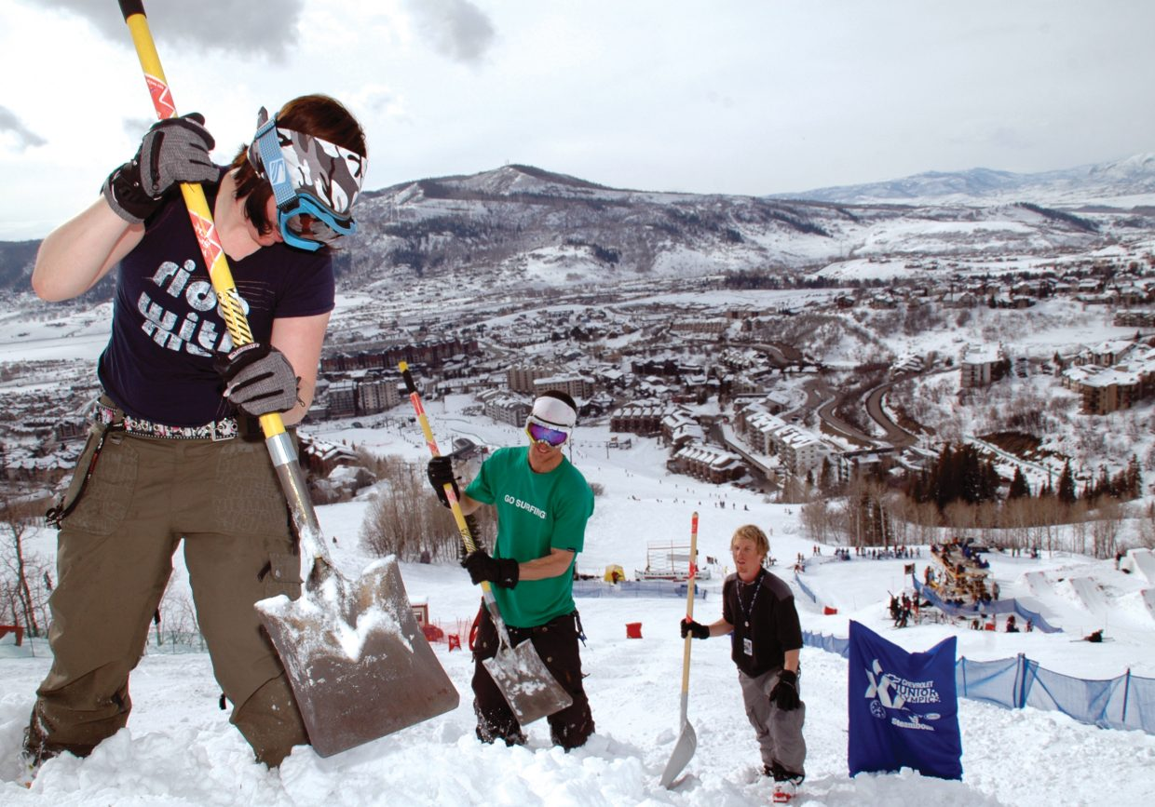
Event Roles

Slide 27
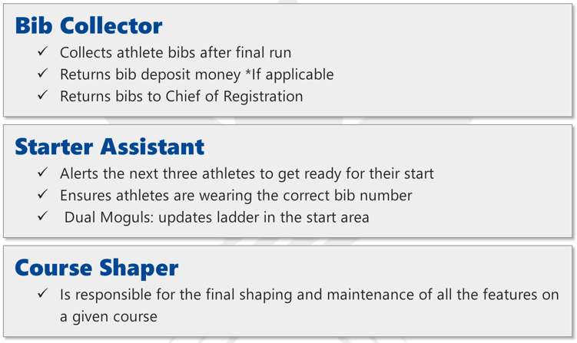
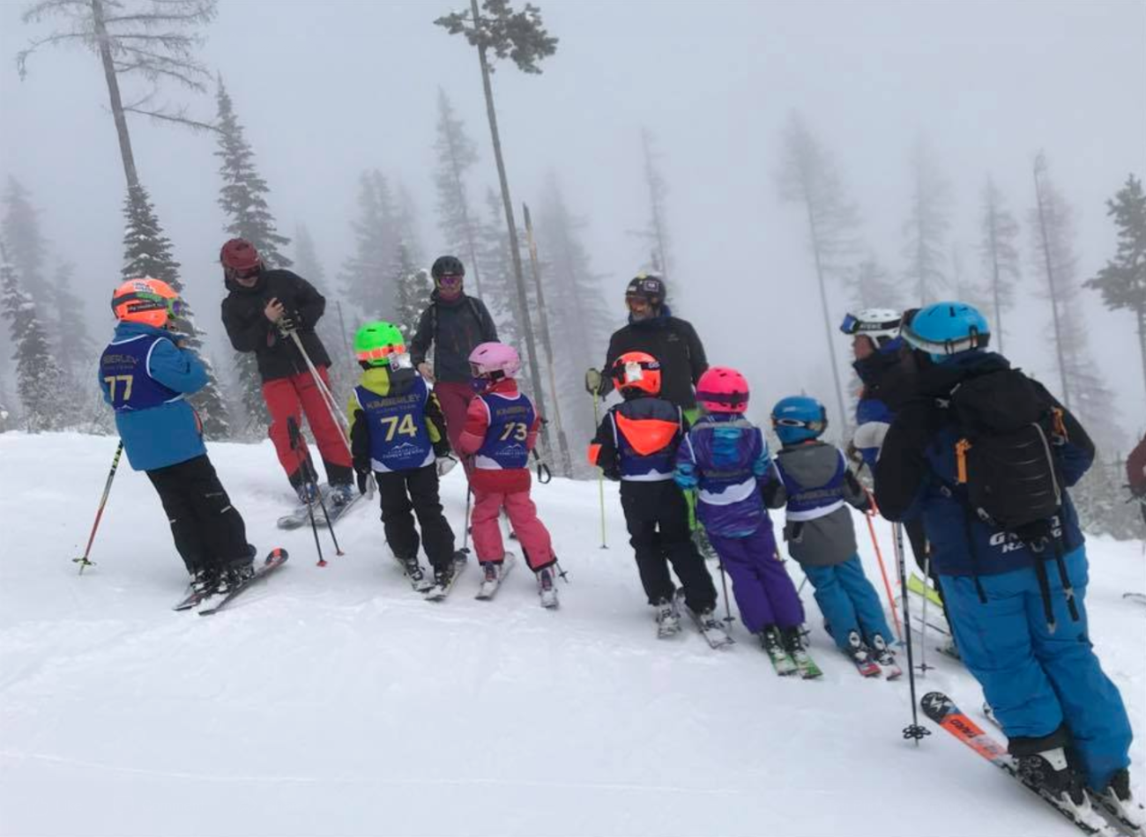
Event Roles

Slide 28
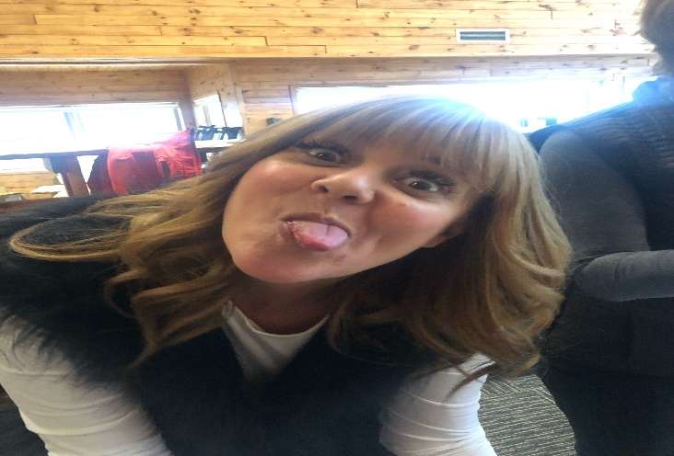
Volunteer Support: You are not alone
Volunteer Coordinator roles have checklists!
At Timber Tours you will have a volunteer coordinator on site.
You have a community there to help you, board members, coaches and other parents who have experience.
You can reach out to me, the volunteer coordinator support person at: natasha@coordinatedaccess.ca
As the activities get closer
we will be in touch to ask you to volunteer;
Please!

Slide 29
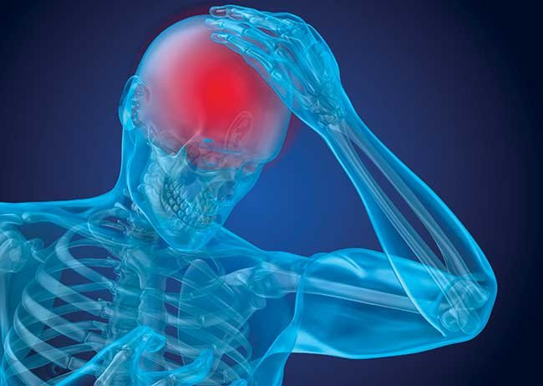
Concussions It’s A Matter of Law

Slide 30
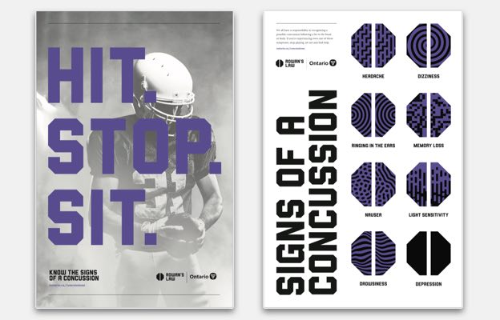
Rowan’s Law
Concussion legislation passed in 2018: took effect on July 1st 2019.
Mandatory:
Clubs to run concussion sessions.
Have concussion policy/protocol
Have a removal and return to sport
process

Slide 31
What is and what causes a Concussion
WHAT IS A CONCUSSION?
A concussion is a brain injury that can’t be seen on x-rays, CT or MRI scans. It affects
the way an athlete thinks and can cause a variety of symptoms
WHAT CAUSES A CONCUSSION?
Any blow to the head, face or neck, or somewhere else on the body that causes a
sudden jarring of the head may cause a concussion. Examples include getting bodychecked
in hockey, hitting one’s head on the floor in the gym class, or landing on your
side or back while landing during a ski jump.

Slide 32
What To Expect
A concussion should be suspected in any athlete who sustains a significant impact to the head, face, neck, or body and report ANY symptoms or demonstrates ANY visual signs of concussion.
A concussion should also be suspected if an athlete reports ANY concussion symptoms to one of their peers, parents, teachers, or coaches or if anyone witnesses an athlete exhibiting ANY of the visual signs of concussion.
Some athletes will develop symptoms immediately while others will develop delayed symptoms
(beginning 24-48 hours after the injury).

Slide 33
Symptoms
WHAT ARE THE SYMPTOMS OF A CONCUSSION?
A person does not need to be knocked out (lose consciousness) to have had a concussion. Common symptoms include:
• Headaches or head pressure
• Easily upset or angered
• Dizziness • Sadness
• Nausea and vomiting • Nervousness or anxiety
• Blurred or fuzzy vision • Feeling more emotional
• Sensitivity to light or sound • Sleeping more or sleeping less
• Balance problems • Having a hard time falling asleep
• Feeling tired or having no energy • Difficulty working on a computer
• Nothing thinking clearly • Difficulty reading
• Feeling slowed down • Difficulty learning new information

Slide 34
Visual Signs of a Concussion
Visual signs of a concussion may include:
• Lying motionless on the playing surface • Blank or vacant stare
• Slow to get up after a direct or indirect hit to the head
• Balance, gait difficulties, motor incoordination, stumbling slow labored movements
• Disorientation or confusion or inability to respond appropriately to questions
• Facial injury after head trauma
• Clutching Head

Slide 35
What To Do
WHAT SHOULD I DO IF I SUSPECT A CONCUSSION?
If any athlete is suspected of sustaining a concussion during sports they should be
immediately removed from play. Any athlete who is suspected of having sustained a concussion during sports must not be allowed to return to the game or practice.
It is important that ALL athletes with a suspected concussion undergo medical assessment by a medical doctor or nurse practitioner, as soon as possible. It is also important that ALL athletes with a suspected concussion receive written medical clearance from a medical doctor or nurse practitioner before returning to sport activities.

Slide 36
When Can An Athlete Return to Sport
It is important that all athletes diagnosed with a concussion follow a step-wise return to school and sports-related activities that includes the following Return-to-School and Return-to-Sports strategies. It is important that youth and adult student-athletes return to full-time school activities before progressing to stage 5 and 6 of the Return-to-Sports strategy

Slide 37
Return To School Strategy
Stage | Aim | Activity | Goal of each step
1 | Daily activities at home that do not give the student/athlete symptoms | Typical activities during the day as long as they do not increase symptoms (i.e. reading, texting, screen time). Start at 5-15 minutes at a time and gradually build up. | Gradual return to typical activities
2 | School activities | Homework, reading or other cognitive activities outside of the classroom. | Increase tolerance to cognitive work
3 | Return to school part-time | Gradual introduction of schoolwork. May need to start with a partial school day or with increased breaks during the day. | Increase academic activities
4 | Return to school full-time | Gradually progress | Return to full academic activities and catch up on missed school work

Slide 38
Return To Sport
Step | Activity Level | Freestyle Ski Context | Symptoms Present
 |  |  | Yes | No
1 | No activity, only complete rest. | Minimum of 24-48 hours of rest. Limit school, work and tasks requiring concentration. Refrain from physical activity until symptoms are gone. |  | A physician, should be consulted before moving to step 2
2 | Light aerobic exercise | Activities such as walking or stationary cycling. Someone who can help monitor for symptoms and signs should supervise the player. No resistance training or weight lifting. The duration and intensity of the aerobic exercise can be gradually increased over time if no symptoms or signs return during the exercise or the next day. Follow this 2-step process with 24 hours of rest between each step. a) Step 1 - 15 minutes on stationary bicycle, rest 24 hrs. If symptom free go to step 2 b) Step 2 - 60 minutes of more aggressive cardio work (75% of max Heart Rate) such as bike or jogging | Return to rest and step 1 until symptoms have resolved. If symptoms persist, consult a physician. | Proceed to Step 3 only if athlete is: asymptomatic after 60 minute cardio session

Slide 39
Return To Sport Con’t
Step | Activity Level | Freestyle Ski Context | Symptoms Present
 |  |  | Yes | No
3 | Sport specific activities | Gentle skiing on flat, easy terrain. No jumping or jarring movements. No bouncing on trampolines. Continuous skiing for 60 minutes | Return to rest until symptoms have resolved then resume at step 2. If symptoms persist, consult a physician. | Proceed to Step 4 the next day if asymptomatic
4 | Begin Discipline Specific Drills (up to moderate intensity) | 60 minutes of continuous discipline-specific training (on or off snow) - Skiing on moderate, terrain with moguls. - Skiing the halfpipe with small, easy jumps. - Riding “ability appropriate” boxes/rails - No big air tricks. - Small bouncing on trampoline or bounding drills. | Return to rest until symptoms have resolved then resume at step 3. If symptoms persist, consult a physician. | The time needed to progress from non-contact exercise will vary with the severity of the concussion and with the player. Proceed to Step 5 with Medical Clearance Only.

Slide 40
Return To Sport Con’t
Step | Activity Level | Freestyle Ski Context | Symptoms present
 |  |  | Yes | No
5 | Begin Sport Specific Drills (up to full intensity) ** | Gradually increase the intensity of training to include all normal training activities | Return to rest until symptoms have resolved then resume at step 4 If symptoms persist, consult a physician. | Proceed to Step 6 the next day.
6 | Game Play | Return to Competition

Slide 41
How Long Will it Take?
Most athletes who sustain a concussion will make a complete recovery within 1-2 weeks while most youth athletes (less than 18 years of age) will recover within 1-4weeks.
Approximately 15-30% of patients will experience persistent symptoms (>2weeks for adults; >4 weeks for youth) that may require additional medical assessment and management.
TO LEARN MORE ABOUT CONCUSSIONS PLEASE VISIT:
https://www.ontario.ca/page/rowans-law-concussion-safety

Slide 42
Communication

Slide 43
How will we communicate with you!
Team snap
Mail chimp
Newsletter
Website
https://www.fortunefreestyle.com/

Slide 44
Questions Inquiring Minds Want to Know!

