Slide 1
Slopestyle and Moguls Judging

Slide 2
Moguls The Basics
A mogul run is scored out of 100 points
Turns = 60 points
Speed = 20 points
Air (Jumps) = 20 points
5 – 7 judges
3 or 5 judges for turns (if 5 judges, highest and lowest scores are dropped)
2 judges for air

Slide 3
Moguls Speed
Max 20 points
Calculated based on a formula using a pace time for a given course:
Men’s Pace Time = 10.30 metres / per second
Women’s Pace Time = 8.80 metres / per second
Time points = 48.00 - 32.00 x (Competitor’s Time / Pace Set Time)
[Max = 20, Min = 0]
If an athlete’s time is greater than 150% of the pace set time, time points are 0.

Slide 4
Moguls Turns
Each judge scores out of 20 (x 3 judges = max 60 points)
Criteria
Carving
Absorption and extension
Upper body
Turns ranges
Excellent 18.1 – 20.0
Very good 16.1 – 18.0
Good 14.1 – 16.0
Above Average 12.1 – 14.0
Competent 10.1 – 12.0
Below average 8.1 – 10.0
Poor 4.1 – 8.0
Very poor 0.1 – 4.0

Slide 5
Moguls Turns - Continued
Deductions
6.0 Any complete stop
4.1 –5.9 Complete fall without stop or interruption/significant sliding down fall line or across hill to nearly a complete stop
2.9 – 4.0 Hard touchdown or front roll without stop or interruption/sliding significantly reducing downhill momentum
2.1 – 2.8 Medium touchdown without stop
0.1 – 2.0 Light touchdown without interruption, small stumbles, fall line deviations, speed check, double pole plant, shooting

Slide 6
Moguls Turns - Continued
Special issues
Loss of control / shooting
Deduction of up to 2 turn points (per judge) per control gate– MAKE SURE YOU CONTINUE TO TURN ALL THE WAY TO THE FINISH LINE
Changing lines
Deduction of 1.6 turn points (per judge) for any complete change in line
No deduction for return to original line
Will typically be accompanied by other deductions – e.g. loss of control leading to line change (up to 2 turn points per control gate per judge…)
Loss of equipment (Timber Tour Rules – awaiting updates for 2019/2020)
In the case of a loss of equipment, the competitor is allowed ten (10) seconds to retrieve it. If the competitor has not resumed his/her run after the ten seconds has elapsed the run will be judged to that point.
The loss of both skis will result in the competitor receiving a turn score up to that point but no speed points.
The competitor must cross the finish line with at least three (3) pieces of equipment for the run to be scored. (Equipment constituting 2 skis and 2 poles).

Slide 7
Moguls Turns - Continued
Special issues - continued
Skiing around control gate = DNF
Crossing centre line (i.e. both boots) in duals = DNF

Slide 8
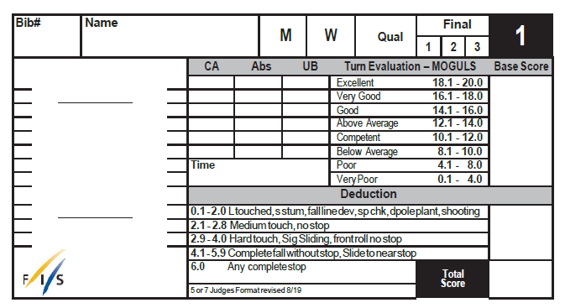
Moguls Turns - Continued
Turns scorecard

Slide 9
Moguls Air
Each air judge scores each jump out of 10 for form, which is then multiplied by a degree of difficulty (DD) multiplier. The two air judge scores are averaged to provide 20 points in the overall score.
Form criteria:
Quality
Athleticism displayed
Control
Balance
Landing continuity of motion
Air (Height and Distance)
Fluidity (the ability of the competitor to maintain the rhythm of turns prior to the jump, including the initiation for take-off)

Slide 10
Moguls Air - Continued
Form point ranges
Excellent Jump 8.1 – 10.0
Good Jump 6.1 – 8.0
Average Jump 4.1 – 6.0
Poor Jump 2.1 – 4.0
Very Poor Jump 0.1 – 2.0
Air in moguls is judged until the competitor is in full control.
If the landing is very poor or completely missed the jump score is affected. The jump may only receive a maximum score of 5.0. Falls and touchdowns also affect the turn score.
Judges must identify and code the tricks performed. Judges must agree on the trick performed.

Slide 11
Moguls Air - Continued
Examples of common trick DDs (M/W)
Single Uprights
Twister (T) or Spread – 0.38/0.48 Daffy (D) or Kosak (K) – 0.41/0.51
Back Scratcher (Y) or Iron Cross (X) – 0.41/0.51
Double Uprights
TT or TS – 0.5/0.6 DD – 0.56/0.66 YS or XS or DT – 0.53/0.63
Triple Uprights
TTS or TTT – 0.61/0.71 DTS – 0.64/0.74 DDD – 0.7/0.8
Rotational Jumps (p – position; G = grab)
3 – 0.65/0.75 3p – 0.68/0.78 3G – 0.78/0.90
7 – 0.85/1.00 7p – 0.88/1.03 7G – 0.98/1.15
Off-axis
3o – 0.71/0.81 3oG – 0.84/0.96
7o – 0.83/0.98 7op – 0.86/1.01 7oG – 0.96/1.13
Flips
Back Pike/Tuck (bP/bT) – 0.70/0.80 Back Lay (bL) – 0.72/0.82
bp – 0.73/0.83 bG – 0.83/0.93
fT – 0.74/0.84 fp – 0.77/0.87 fG – 0.87/1.02
Loop (l) – 0.71/0.81 lp – 0.74/0.84 lG – 0.83/0.94

Slide 12
Moguls Air - Continued
Note: a grab can be performed to “modify” another trick (typically rotations and flips) and will increase the DD as shown in the examples above. A grab cannot be performed as a trick on its own.
“Repeat Rule”
A competitor must perform two different jumps in a run. If a jump is repeated, only the first scoring jump will count for that run.
In addition to identical jumps, the following rules also apply:
Two uprights are considered the same jump unless they differ in number of moves (e.g. single vs. double), or a grab is added (e.g. iron cross vs. iron cross with a grab)
Two rotational jumps (including off-axis) must differ in number of rotations (e.g. 3 vs 7), or addition of a grab. Changing the direction of rotation does not change the jump.
Two inverts must differ in direction (e.g. front vs back), addition of rotation (e.g. lay v full), or addition of a grab

Slide 13
Moguls Air - Continued
Grabs must be held to be clearly presented to the judges and identifiable as a grab. Attempted and missed grabs will typically result in a jump score in the “poor” or “very poor” range (i.e. max score 4.0).
It is generally better to perform an easier trick well, rather than a harder trick less well.
E.g. when performing his best, Jack can perform excellent single uprights, good doubles, and average triples.
Excellent S = 8.1 – 10 x DD (0.38) = 3.1 – 3.8
Good TS = 6.1 – 8.0 x DD (0.5) = 3.1 – 4.0
Average TTS = 4.1 – 6.0 x DD (0.61) = 2.5 – 3.7
Unless Jack can improve the execution of the harder tricks – he will likely not get a better score for performing the harder tricks (and may do worse if he performs the hard tricks poorly)

Slide 14
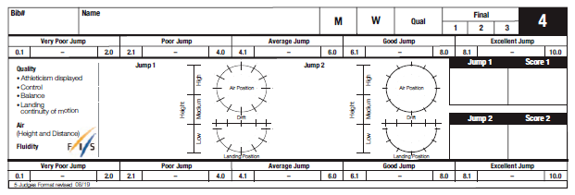
Moguls Air - Continued
Air scorecard

Slide 15
Moguls Putting it all Together
How it looks on the scoresheet
Kingsbury – Ruka 2018/2019 season
Nguyen – Fortune 2019

Slide 16
Moguls Duals
Typical format for duals on Timber Tour has been 5 judges – two turns, one air, one “overall” + speed
Each judge allocates 5 marks to the read or blue course (i.e. 5-0, 4-1, 3-2, 2-3, 1-4, 0-5)
Speed points are allocated based on time difference between the competitors
time difference less than or equal to 0.74 seconds (~<7m): 3/2
time difference between 0.75 and 1.49 seconds (~7-14m): 4/1
time difference equal to or greater than 1.5 seconds(~14+m): 5/0
Key point: it is not always the first finisher who wins (turns and air still count for ~80% of the scoring)

Slide 17
Moguls Resources
Judges manual: https://assets.fis-ski.com/image/upload/v1570543090/fis-prod/assets/Freestyle_Skiing_Judging_Handbook.pdf
Mogul jump DD: https://assets.fis-ski.com/image/upload/v1565178614/fis-prod/assets/Mogul_DD_Version.pdf

Slide 18
Slope The Basics
All judging is based on “Overall Impression”
Criteria: P.A.V.E.D.
Progression
Amplitude
Variety
Execution
Difficulty
The objective is to create the correct ranking, rather than a correct score. In the result, the same run in one competition may achieve a very different score in a different competition.

Slide 19
Slope Progression
Judges will reward creativity and originality
Athletes who use the course differently than the others will be rewarded:
Creative lines through the course will be rewarded (e.g. side hits, transfers)
Unique tricks that are less common can set an athlete apart
BUT – when athletes are doing new, less common tricks they still should be performed cleanly
E.g. Nose butter 270 onto a rail (can easily look sketchy if not done correctly)
E.g. Hand drag 360 off a jump (can look back seat and can kill speed/amplitude if done poorly)
E.g. Newer grabs that the judges may not be familiar with, need to be especially pronounced and clear

Slide 20
Slope Amplitude
Going big can give an athlete that wow factor.
Knuckling a jump on the other hand, not only looks bad and affects their jump score, but can also hurt an athlete’s speed and affect the flow of their run.

Slide 21
Slope Variety
Judges will want to see a good mix of switch and regular tricks as well as tricks that are spun both ways
Spinning both ways is very important - judges definitely notice this.
Tricks should not be repeated – unless spun the other way
Different types of rotations or tricks spun on a different axis can add variety
E.g. Upright 720 vs. rodeo 720 vs. misty 720 vs. corked 720

Slide 22
Slope Variety - Continued
BUT – Athletes need to consider a few things:
No reverts – ever. If an athlete can only fit a switch trick into their run by doing a revert – it’s not worth it. Reverts kill the flow of a run and basically make it a write off. (Both Bryan Snow and I have observed that reverts really kill scores … and should be avoided if at all possible.)

Slide 23
Slope Execution
The obvious…
No hand drags or butt checks on landings
No wash-outs or reverts on landings
Clean visible grabs:
No boot grabs
Judges are looking for actual grabs on the skis, not just touches
The longer a grab is held, the better
If an athlete is not grabbing, then they should look calm and in control in the air (no flailing)

Slide 24
Slope Execution - Continued
Sliding the entire length of rails is key. Coming off early can kill momentum and flow of a run.
When athletes don’t pop off jumps, it is pretty noticeable and doesn’t look good
Sucking up take offs gives more of a flat trajectory, it generally looks bad and also affects amplitude.

Slide 25
Slope Difficulty
Amount of rotation is definitely not the only thing that is considered
More importantly, judges will consider variety, which adds to difficulty:
Direction of rotations
Switch vs. Forward tricks
Grabs and how they are combined with certain tricks
NOTE: Style and variety seem to be getting more important in slope judging. This basically means that more emphasis is being placed on how good tricks look and whether athletes can spin both ways. Don’t just “spin to win”.

Slide 26
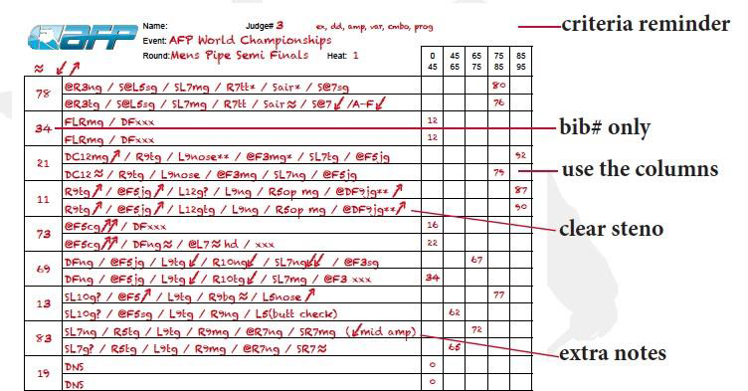
Slope Judges’ Sheet

Slide 27
Slope Resources
More information on judging is available from the Association of Freeskiing Professionals (AFP) website:
http://www.afpjudges.com/general-info/judging-philosophy
Special thanks to Bryan Snow for his assistance in putting this presentation together!

Slide 28
Questions Inquiring Minds Want to Know!

